Slide 1
Agenda & Executive Summary of the data
-> Contents of the ppt
-> Problem statement
-> About Data (Info, Shape, Summary Stats, your assumptions about data)

Slide 2
CONTENTS OF PRESENTATION
Description of the content | Slide No’s
1. Agenda & Executive Summary of the data | 1-6
2.Exploratory Analysis and Inferences | 7-19
3. Customer Segmentation using RFM analysis (4 segments) | 20-30
4. Inferences from RFM Analysis and identified segments | 31-35
CONCLUSIONS AND RECOMMENDATIONS | 36

Slide 3
PROBLEM STATEMENT
DATA DICTIONARY
An automobile parts manufacturing company has collected data of transactions for 3 years. They do not have any in-house data science team, thus they have hired you as their consultant. Your job is to use your magical data science skills to provide them with suitable insights about their data and their customers.
Auto Sales Data: Sales_Data.xlsx
AGENDA
Recommend customized marketing strategies for different segments of customers
ORDERNUMBER : | Order Number | CUSTOMERN AME : | customer
QUANTITYORDE RED : | Quantity ordered | PHONE : | Phone of the customer
PRICEEACH : | Price of Each item | ADDRESSLINE 1 : | Address of customer
ORDERLINENUM BER : | order line | CITY : | City of customer
SALES : | Sales amount | POSTALCODE : | Postal Code of customer
ORDERDATE : | Order Date | COUNTRY : | Country customer
DAYS_SINCE_LAS TORDER : | Days_ Since_Lastorder | CONTACTLAS TNAME : | Contact person customer
STATUS : | Status of order like Shipped or not | CONTACTFIRS TNAME : | Contact person customer
PRODUCTLINE : | Product line – CATEGORY | DEALSIZE : | Size of the deal based on Quantity and Item Price
MSRP : | Manufacturer's Suggested Retail Price
PRODUCTCODE : | Code of Product |  | 3

Slide 4
DATA INFORMATION
<class 'pandas.core.frame.DataFrame'>
RangeIndex: 2747 entries, 0 to 2746
Data columns (total 20 columns):
# Column Non-Null Count Dtype
--- ------ -------------- -----
0 ORDERNUMBER 2747 non-null int64
1 QUANTITYORDERED 2747 non-null int64
2 PRICEEACH 2747 non-null float64
3 ORDERLINENUMBER 2747 non-null int64
4 SALES 2747 non-null float64
5 ORDERDATE 2747 non-null datetime64[ns]
6 DAYS_SINCE_LASTORDER 2747 non-null int64
7 STATUS 2747 non-null object
8 PRODUCTLINE 2747 non-null object
9 MSRP 2747 non-null int64
10 PRODUCTCODE 2747 non-null object
11 CUSTOMERNAME 2747 non-null object
12 PHONE 2747 non-null object
13 ADDRESSLINE1 2747 non-null object
14 CITY 2747 non-null object
15 POSTALCODE 2747 non-null object
16 COUNTRY 2747 non-null object
17 CONTACTLASTNAME 2747 non-null object
18 CONTACTFIRSTNAME 2747 non-null object
19 DEALSIZE 2747 non-null object
dtypes: datetime64[ns](1), float64(2), int64(5), object(12)
memory usage: 429.3+ KB
Import following libraries in Jupyter notebook
pandas, matplotlib, seaborn,
TYPES OF VARIABLES:
a. Integer type/numeric: ORDER NUMBER, QUANTITY ORDERED, PRICE EACH, ORDER LINENUMBER, SALES, DAYS_SINCE_LASTORDER, MRSP
b. Nominal/Object type: STATUS, PRODUCTLINE, PRODUCTCODE, CUSTOMERNAME, PHONE, ADDRESSLINE1, CITY, POSTALCODE, COUNTRY, CONTACTLASTNAME, CONTACTFIRSTNAME, DEALSIZE
c. Date type: ORDER DATE, DAYS_SINCE_LASTORDER
No missing values in the dataset
No duplicates in the dataset
Shape of the dataset: 20 columns and 2747 rows
4

Slide 5
SUMMARY STATS OF THE DATASET
 | count | unique | top | freq | first | last | mean | std | min | 25% | 50% | 75% | max
ORDERNUMBER | 2747 | NaN | NaN | NaN | NaT | NaT | 10259.8 | 91.8775 | 10100 | 10181 | 10264 | 10334.5 | 10425
QUANTITYORDERED | 2747 | NaN | NaN | NaN | NaT | NaT | 35.103 | 9.76214 | 6 | 27 | 35 | 43 | 97
PRICEEACH | 2747 | NaN | NaN | NaN | NaT | NaT | 101.099 | 42.0425 | 26.88 | 68.745 | 95.55 | 127.1 | 252.87
ORDERLINENUMBER | 2747 | NaN | NaN | NaN | NaT | NaT | 6.49108 | 4.23054 | 1 | 3 | 6 | 9 | 18
SALES | 2747 | NaN | NaN | NaN | NaT | NaT | 3553.05 | 1838.95 | 482.13 | 2204.35 | 3184.8 | 4503.09 | 14082.8
ORDERDATE | 2747 | 246 | 14-11-2018 00:00 | 38 | 06-01-2018 | 31-05-2020 | NaN | NaN | NaN | NaN | NaN | NaN | NaN
DAYS_SINCE_LASTORDER | 2747 | NaN | NaN | NaN | NaT | NaT | 1757.09 | 819.281 | 42 | 1077 | 1761 | 2436.5 | 3562
STATUS | 2747 | 6 | Shipped | 2541 | NaT | NaT | NaN | NaN | NaN | NaN | NaN | NaN | NaN
PRODUCTLINE | 2747 | 7 | Classic Cars | 949 | NaT | NaT | NaN | NaN | NaN | NaN | NaN | NaN | NaN
MSRP | 2747 | NaN | NaN | NaN | NaT | NaT | 100.692 | 40.1148 | 33 | 68 | 99 | 124 | 214
PRODUCTCODE | 2747 | 109 | S18_3232 | 51 | NaT | NaT | NaN | NaN | NaN | NaN | NaN | NaN | NaN
CUSTOMERNAME | 2747 | 89 | Euro Shopping Channel | 259 | NaT | NaT | NaN | NaN | NaN | NaN | NaN | NaN | NaN
PHONE | 2747 | 88 | (91) 555 94 44 | 259 | NaT | NaT | NaN | NaN | NaN | NaN | NaN | NaN | NaN
ADDRESSLINE1 | 2747 | 89 | C/ Moralzarzal, 86 | 259 | NaT | NaT | NaN | NaN | NaN | NaN | NaN | NaN | NaN
CITY | 2747 | 71 | Madrid | 304 | NaT | NaT | NaN | NaN | NaN | NaN | NaN | NaN | NaN
POSTALCODE | 2747 | 73 | 28034 | 259 | NaT | NaT | NaN | NaN | NaN | NaN | NaN | NaN | NaN
COUNTRY | 2747 | 19 | USA | 928 | NaT | NaT | NaN | NaN | NaN | NaN | NaN | NaN | NaN
CONTACTLASTNAME | 2747 | 76 | Freyre | 259 | NaT | NaT | NaN | NaN | NaN | NaN | NaN | NaN | NaN
CONTACTFIRSTNAME | 2747 | 72 | Diego | 259 | NaT | NaT | NaN | NaN | NaN | NaN | NaN | NaN | NaN
DEALSIZE | 2747 | 3 | Medium | 1349 | NaT | NaT | NaN | NaN | NaN | NaN | NaN | NaN | ⁵ NaN

Slide 6
ASSUMPTIONS ON DATA
THE AUTOMOBILE COMPANY HAS 89 UNIQUE CUSTOMERS WHO INDULGED WITH TRANSACTIONS IN THREE YEARS SPAN.
THESE CUSTOMERS ARE TO BE SEGMENTED SUCH THAT WE CAN IDENTIFY BENEFICIAL , LOYAL, CUSTOMERS ON CHURN ETC. SO THAT THE BUSINESS STRATEGIES CAN BE FRAMED FOR THE BENEFITS OF THE COMPANY.

Slide 7
Exploratory Analysis and Inferences
-> Univariate, Bivariate, and multivariate analysis using data visualization (Weekly, Monthly, Quarterly, Yearly Trends in Sales and Sales Across different Categories of different features in the given data)
-> Summarise the inferences
UNIVARIATE (DISTRIBUTION, BOXPLOT), BIVARIATE (STRIP PLOT FOR SALES AND OTHER CATEGORICAL VARIABLES, PAIRPLOT FOR NUMERICAL VARIBLES WITH HUE AS SALES) AND MULTIVARIATE (CORRELATION) ANALYSIS WERE DONE IN JUPYTER NOTEBOOK USING PYTHON CODE BY READING THE EXCEL DATASET PROVIDED AND IMPORTING THE NECESSARY LIBRARIES OF PANDAS, MATPLOTLIB AND SEABORN

Slide 8
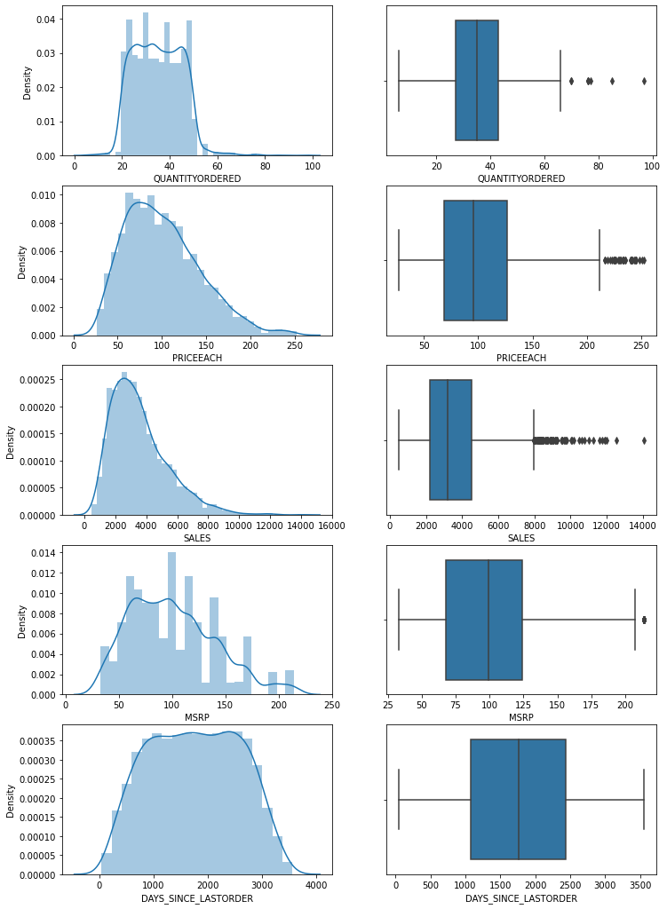
DISTRIBUTION PLOT
BBOOXXPPLLOOTT
UNIVARIATE ANALYSIS
INFERENCE:
Distribution plots reveal skewness towards left for price each, sales and almost uniform distribution for quantity ordered, mrsp as well as days_since_lastorder.
Box plots show the outliers for numerical variables of quantity ordered, priceeach, sales and msrp.

Slide 9
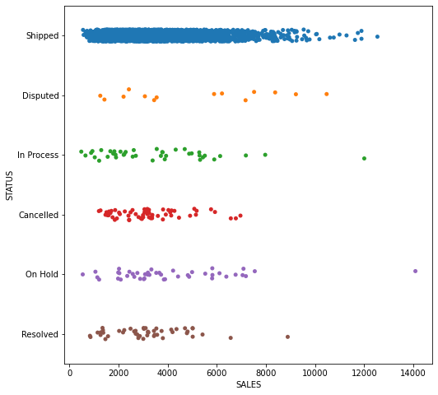
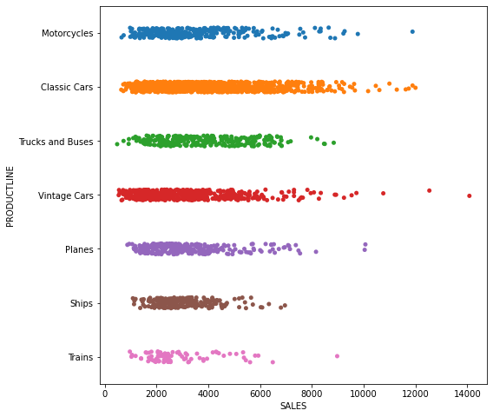
BIVARIATE ANALYSIS STRIP PLOT
INFERENCE:
STRIP plots SALES VS STATUS SHOW SHIPPED ITEMS WITH MANY SALES WITH FEW DISPUTED SALES.
STRIP plots SALES VS PRODUCTIVE SHOW CLASSIC CARS WITH MANY SALES AND TRAINS FOR LESSER SAL9ES.

Slide 10
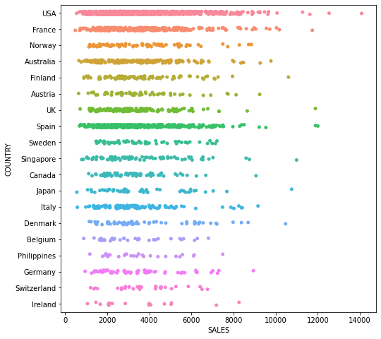
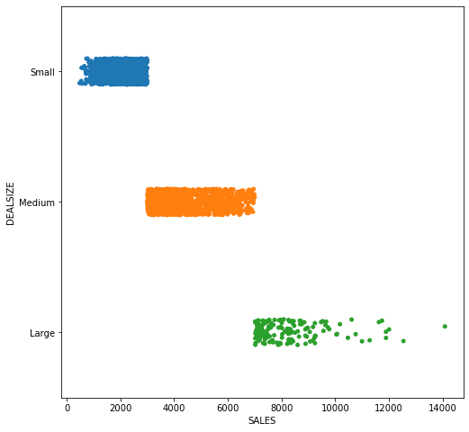
BIVARIATE ANALYSIS STRIP PLOT
INFERENCE:
STRIP plots SALES VS COUNTRY SHOW MORE SALES FOR USA AND LESS SALES FOR IRELAND.
STRIP plots SALES VS DEALSIZE SHOW MORE SALES FOR MEDIUM DEAL SIZE.
10

Slide 11
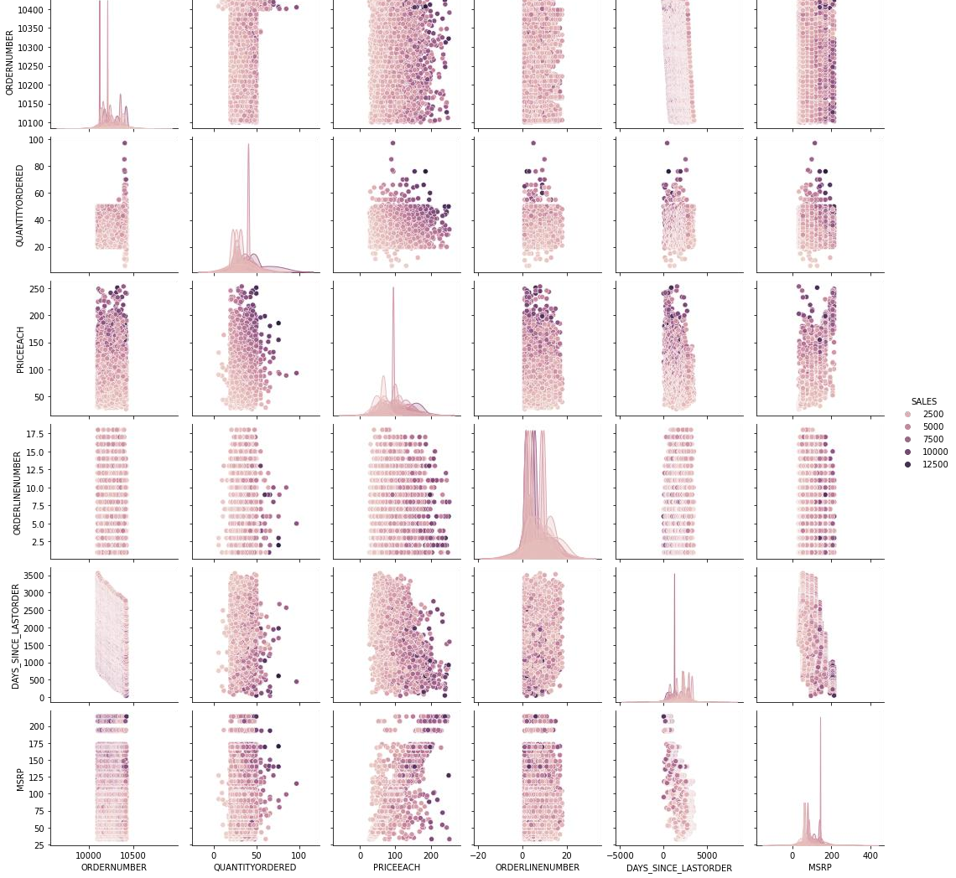
PAIR PLOT
BIVARIATE ANALYSIS
INFERENCE: HISTOGRAMS ACROSS DIAGONAL BETWEEN 2 NUMERICAL VARIABLES SHOW ALMOST UNIFORM DISTRIBUTION WITH RESPECT TO SALES. SCATTER PLOT REVEALING SALES BETWEEN NUMERICAL VARIABLES VIZ., MSRP, ORDERLINENUMBER; MSRP,QUANTITY ORDERED ETC.

Slide 12
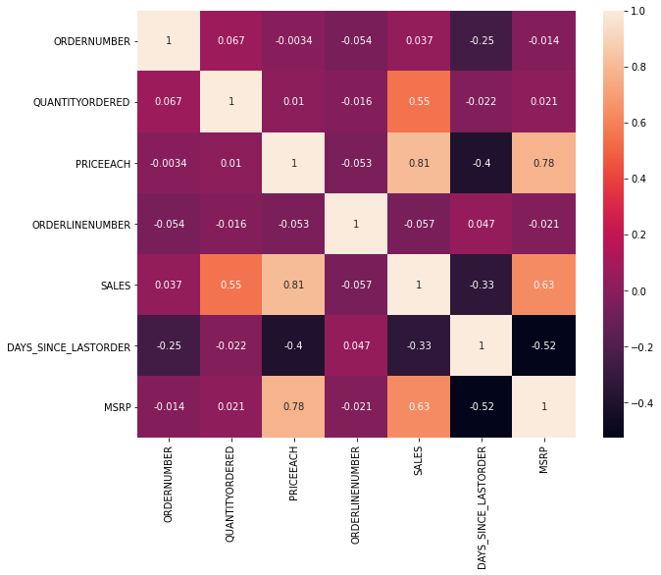
HEATMAP
MULTIVARIATE ANALYSIS
INFERENCE:
HIGHEST CORREALTION IS NOTICED BETWEEN SALES AND PRICE EACH (0.81), FOLLOWED BY MSRP AND PRICE EACH (0.78), SALES AND QUANTITY ORDERED (0.55).

Slide 13
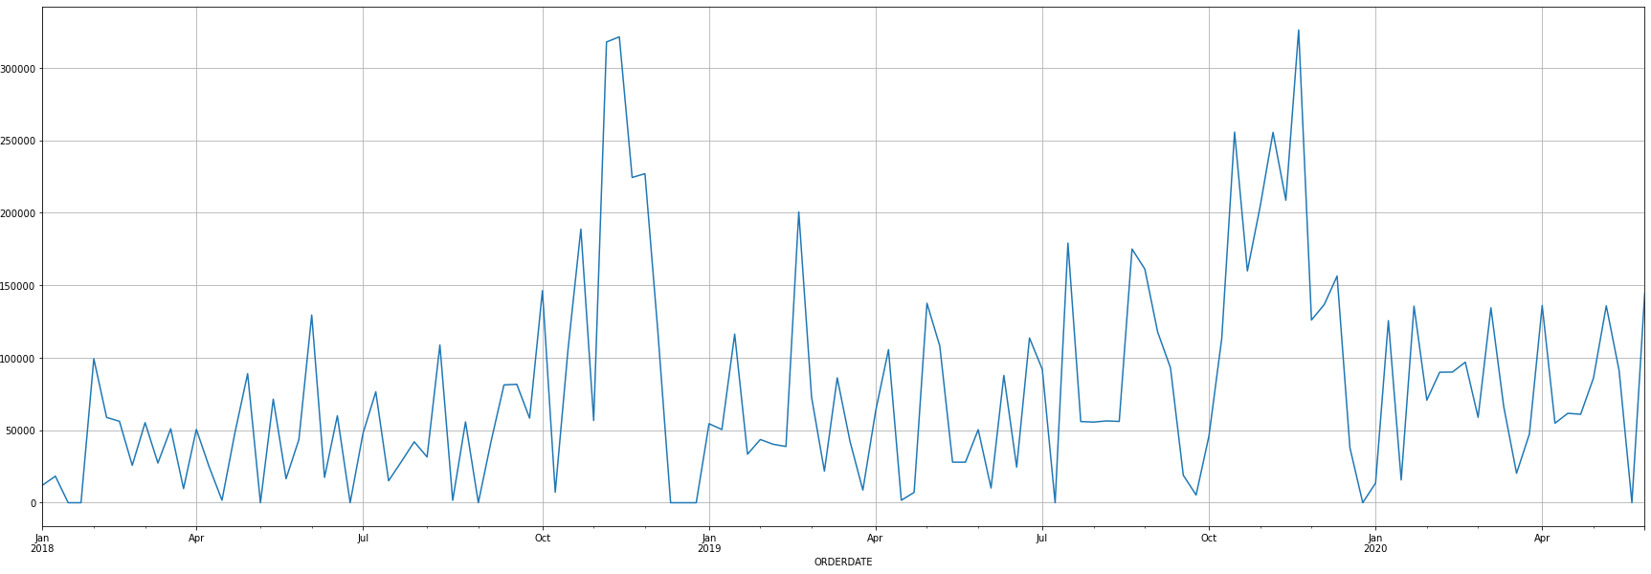
WEEKLY SALES VARIATION
INFERENCE: TREND OF WEEKLY SALES VARIATION SHOWED PEAK IN WEEKS OF MID NOVEMBER IN 2018 AND 2019

Slide 14
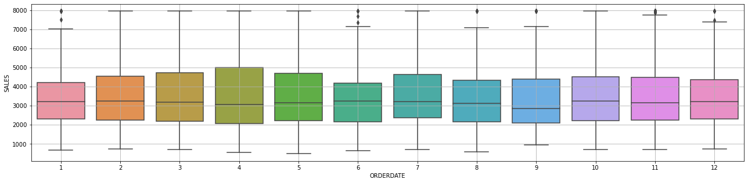
MONTHLY SALES VARIATION
INFERENCE: HIGHEST SALES FOR FOURTH MONTH OR IN APRIL

Slide 15
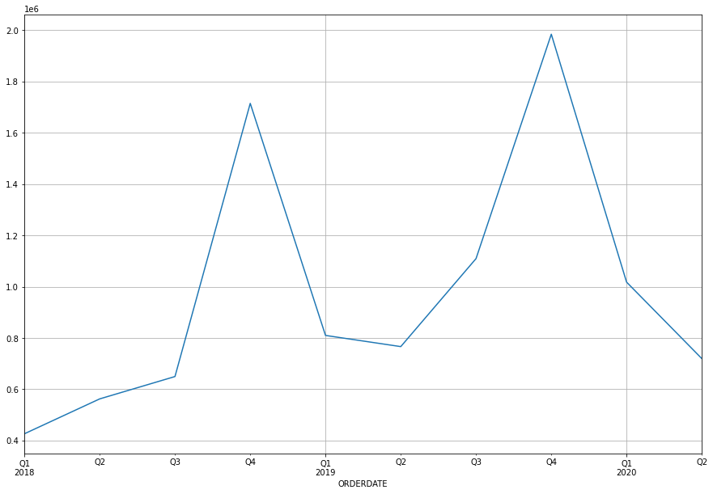
QUARTERLY SALES VARIATION
INFERENCE: HIGHEST SALES FOR FOURTH QUARTER
15

Slide 16
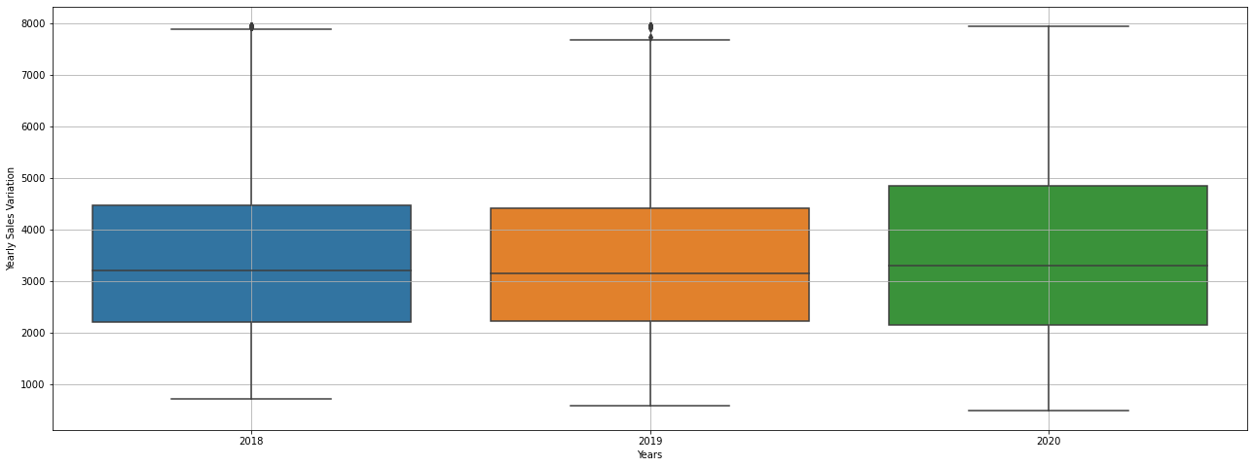
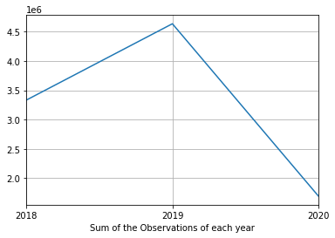
YEARLY SALES VARIATION
INFERENCE: HIGHEST QUARTILE RANGE FOR 2020 WITH MAXIMUM NO. FOR 2019

Slide 17
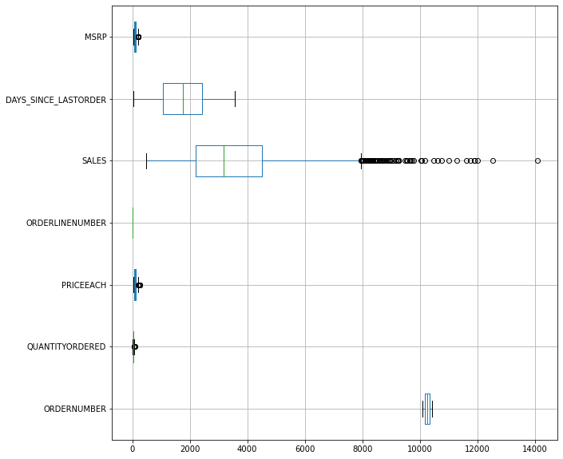
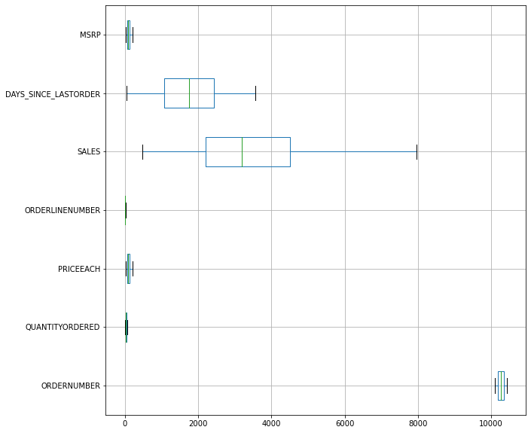
BOX PLOT FOR NUMERIC VARIABLES
WITH OUTLIERS REMOVED OUTLIERS

Slide 18
SUMMARY OF EDA
Distribution plots reveal skewness towards left for price each, sales and almost uniform distribution for quantity ordered, mrsp as well as days_since_lastorder.
Box plots show the outliers for numerical variables of quantity ordered, priceeach, sales and
msrp.
STRIP plots SALES VS STATUS SHOW SHIPPED ITEMS WITH MANY SALES WITH FEW DISPUTED SALES.
STRIP plots SALES VS PRODUCTIVE SHOW CLASSIC CARS WITH MANY SALES AND TRAINS FOR LESSER SALES.
STRIP plots SALES VS COUNTRY SHOW MORE SALES FOR USA AND LESS SALES FOR IRELAND. STRIP plots SALES VS DEALSIZE SHOW MORE SALES FOR MEDIUM DEAL SIZE.
HISTOGRAMS ACROSS DIAGONAL BETWEEN 2 NUMERICAL VARIABLES SHOW ALMOST UNIFORM
DISTRIBUTION WITH RESPECT TO SALES.
SCATTER PLOT REVEALING SALES BETWEEN NUMERICAL VARIABLES VIZ., MSRP, ORDERLINENUMBER; MSRP,QUANTITY ORDERED ETC.
HIGHEST CORREALTION IS NOTICED BETWEEN SALES AND PRICE EACH (0.81), FOLLOWED BY MSRP AND PRICE EACH (0.78), SALES AND QUANTITY ORDERED (0.55).

Slide 19
SUMMARY OF EDA
TREND OF WEEKLY SALES VARIATION SHOWED PEAK IN WEEKS OF MID NOVEMBER IN 2018 AND 2019
HIGHEST SALES FOR FOURTH MONTH OR IN APRIL HIGHEST SALES FOR FOURTH QUARTER
HIGHEST QUARTILE RANGE FOR 2020 WITH MAXIMUM NO. FOR 2019

Slide 20
Customer Segmentation using RFM analysis (4 segments)
-> Which tool used?
-> What all parameters used and assumptions made?
->If KNIME used, Workflow image to be put
-> Output table head

Slide 21
PARAMETERS USED AND ASSUMPTIONS MADE
THE TOOL USED FOR CUSTOMER SEGMENTATION IS RFM ANALYSIS USING KNIME ANALYSIS PLATFORM
PARAMETER USED AND ASSUMPTIONS MADE
RECENCY FOR THE DAYS_SINCE LASTORDER VARIABLE
FREQUENCY FOR THE QUANTITY ORDERED VARIABLE
MONETARY IS PRICE EACH MULTIPLIED BY QUANTITY ORDERED WHICH IS SIMILAR TO SALES VARIABLE
RFM DONE FOR SALES BASED ON CUSTOMER NAME

Slide 22
CUSTOMER SEGMENTATION USING RFM ANALYSIS
THE CUSTOMERS WERE DIVIDED INTO FOUR BINS I.E. BIN-1, BIN-2, BIN-3, BIN-4 AND MAPPED THEM TO RECENCY, FREQUENCY AND MONETARY COLUMNS.
ASSUMPTIONS
 | RECENCY | FREQUENCY | MONETARY
BIN 1 | H | V_L | V_L
BIN 2 | M | L | L
BIN 3 | L | M | M
BIN 4 | V_L | H | H
H: HIGH; M: MEDIUM; L: LOW; V_L: VERYLOW

Slide 23
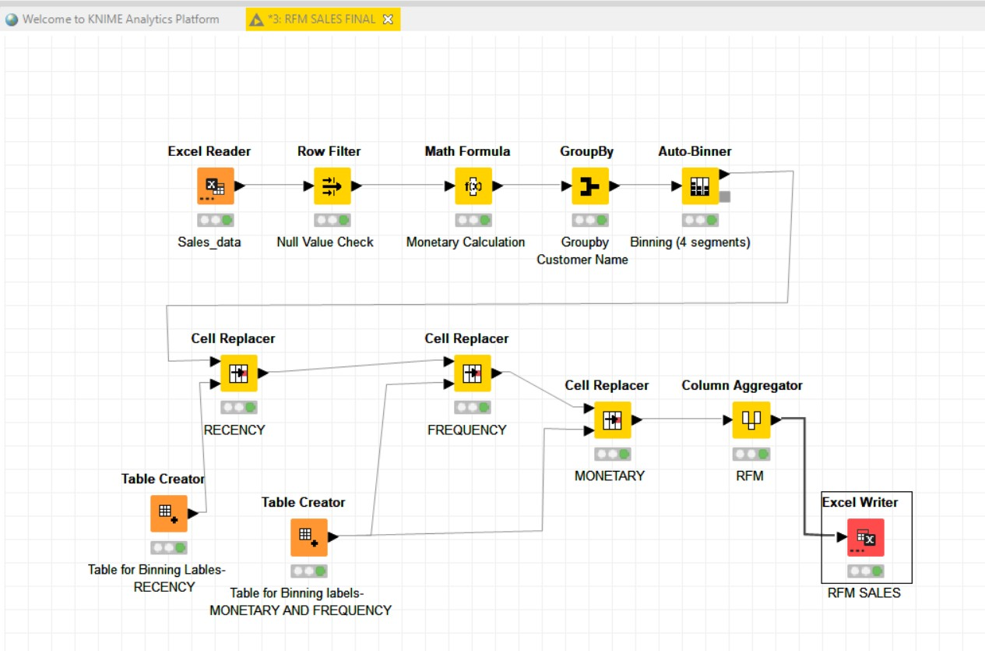
KNIME WORK FLOW
Nodes used are
READ SALES DATA: Excel Reader
NULL VALUE CHECK: ROW FILLER
MONETARY CALCULATION: MATH FORMULA
GROUP BY: GROUPBY NODE
AUTOBINNING: AUTOBINNER
TABLE FOR BINNING RECENCY, MONETARY AND FREQUENCY: Table Binner
Recency, frequency and monetary value replacer using cell replacer for reapective table reader nodes.
Aggregating columns using column aggregator node and RFM is generated and the writing the data using excel reader as RFM SALES

Slide 24
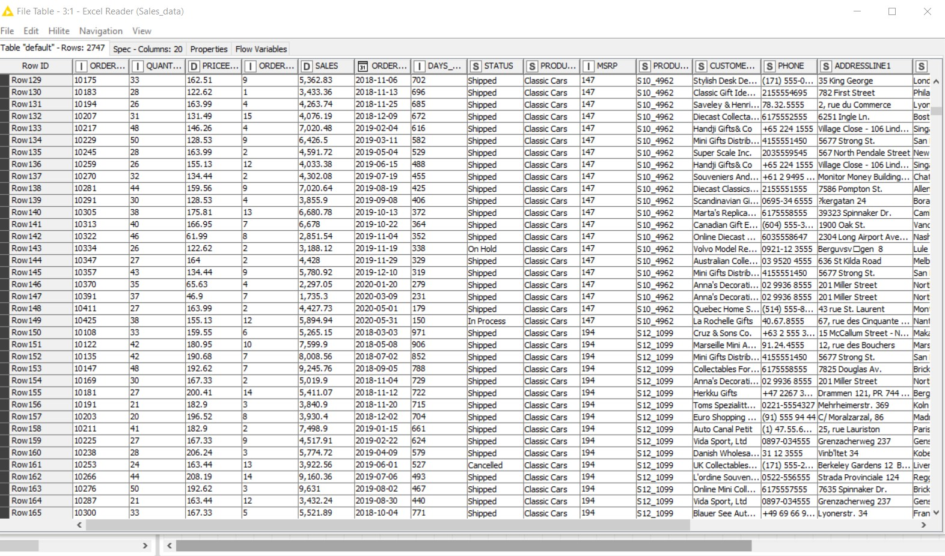
READ EXCEL FILE “SALES_DATA.XLSX” IN EXCEL READER NODE OF KNIME
WITH ITS OUTPUT TABLE

Slide 25
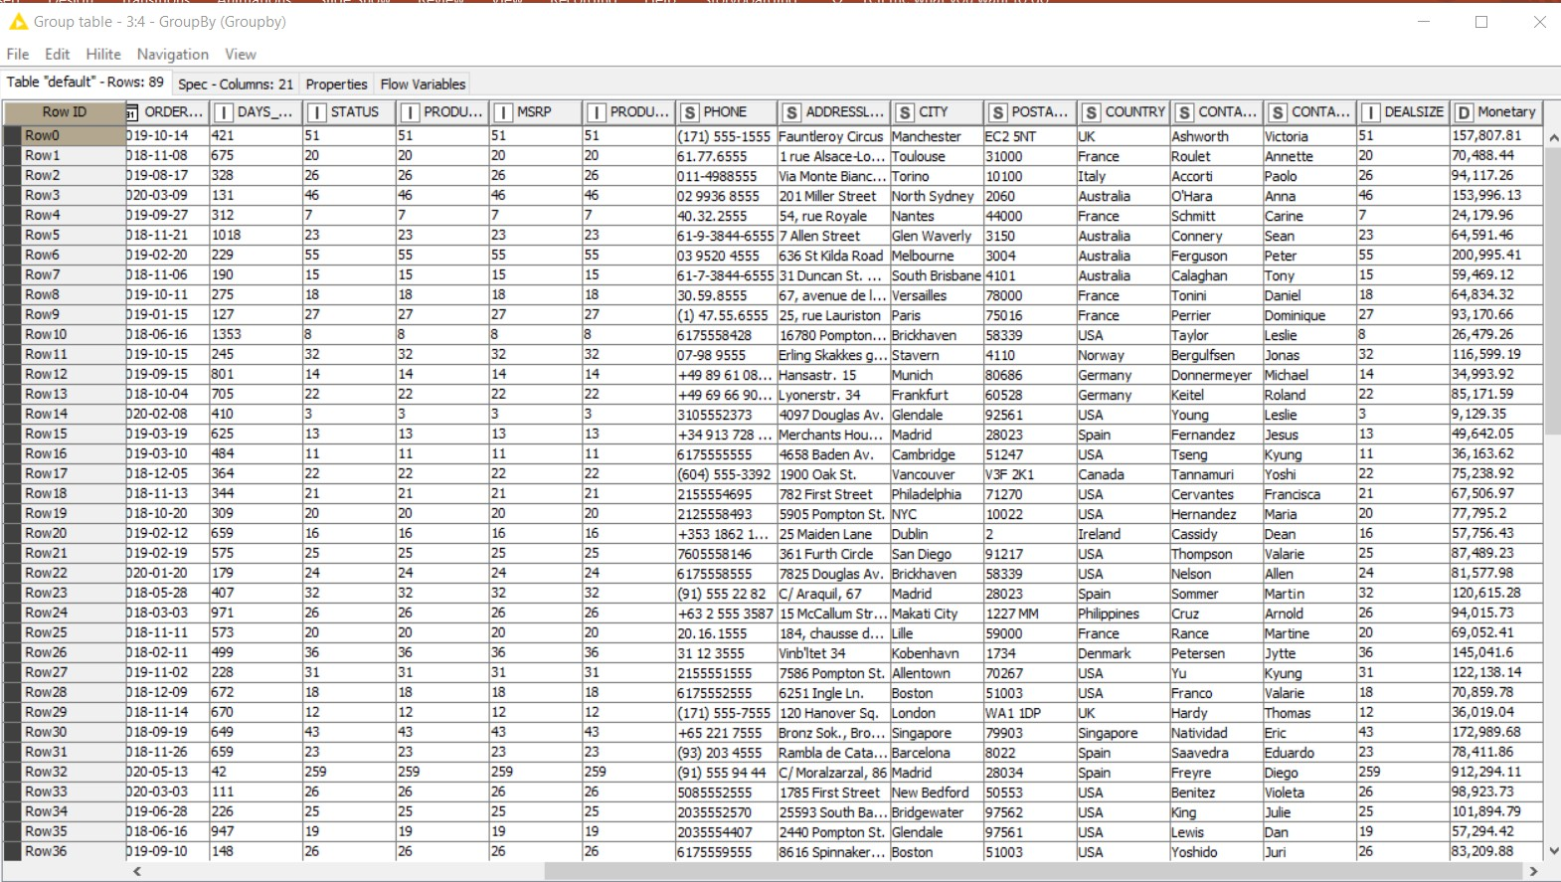
GROUP BY “CUSTOMER NAME” IN GROUPBY NODE OF KNIME WITH ITS
OUTPUT TABLE

Slide 26
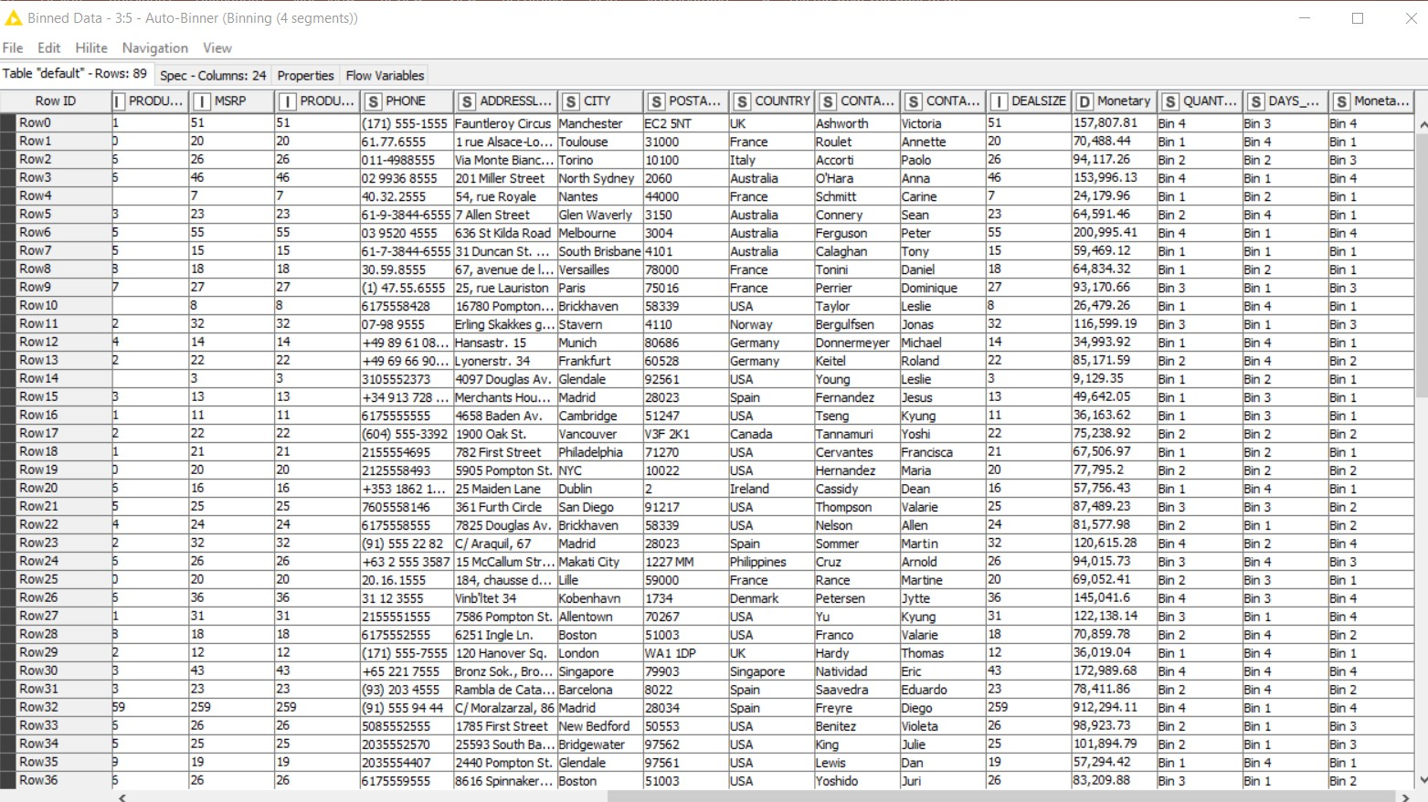
AUTOBINNER FOR QUANTITY ORDERED (FREQUENCY), DAYS_ SINCE LAST ORDER (RECENCY), SALES OR QUANTITY ORDERED MULTIPLIED BY PRICE EACH (MONETARY) KNIME WITH ITS OUTPUT TABLE

Slide 27
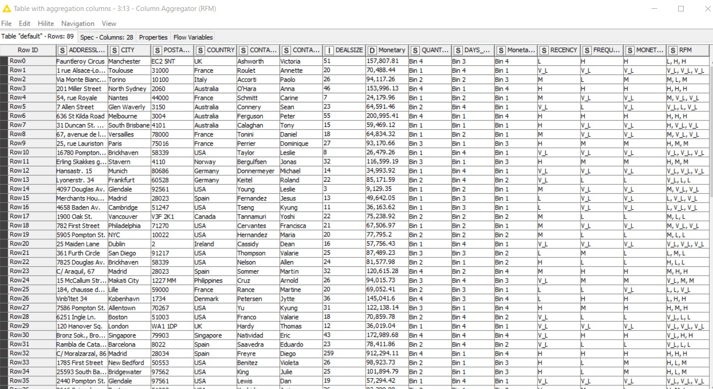
OUTPUT TABLE SHOWING RFM FOR CUSTOMERS BASED ON COLUMN AGGREGATOR NODE OF KNIME

Slide 28
RFM SEGMENTATION FOR VARIOUS CUSTOMER NAME
CUSTOMERNAME | RFM
AV Stores, Co. | L, H, H
Alpha Cognac | V_L, V_L, V_L
Amica Models & Co. | M, L, M
Anna's Decorations, Ltd | H, H, H
Atelier graphique | M, V_L, V_L
Australian Collectables, Ltd | V_L, L, V_L
Australian Collectors, Co. | H, H, H
Australian Gift Network, Co | H, V_L, V_L
Auto Assoc. & Cie. | M, V_L, V_L
Auto Canal Petit | H, M, M
Auto-Moto Classics Inc. | V_L, V_L, V_L
Baane Mini Imports | H, M, M
Bavarian Collectables Imports, Co. | V_L, V_L, V_L
Blauer See Auto, Co. | V_L, L, L
Boards & Toys Co. | M, V_L, V_L
CUSTOMERNAME | RFM
CAF Imports | L, V_L, V_L
Cambridge Collectables Co. | L, V_L, V_L
Canadian Gift Exchange Network | M, L, L
Classic Gift Ideas, Inc | M, V_L, V_L
Classic Legends Inc. | M, L, L
Clover Collections, Co. | V_L, V_L, V_L
Collectable Mini Designs Co. | L, M, L
Collectables For Less Inc. | H, L, L
Corrida Auto Replicas, Ltd | M, H, H
Cruz & Sons Co. | V_L, M, M
Daedalus Designs Imports | L, L, V_L
Danish Wholesale Imports | L, H, H
Diecast Classics Inc. | H, M, H
Diecast Collectables | V_L, L, L
Double Decker Gift Stores, Ltd | V_L, V_L₂₈, V_L

Slide 29
RFM SEGMENTATION FOR VARIOUS CUSTOMER NAME
CUSTOMERNAME | RFM
Dragon Souveniers, Ltd. | V_L, H, H
Enaco Distributors | V_L, L, L
Euro Shopping Channel | H, H, H
FunGiftIdeas.com | H, L, M
Gift Depot Inc. | H, L, M
Gift Ideas Corp. | V_L, V_L, V_L
Gifts4AllAges.com | H, M, L
Handji Gifts& Co | L, H, M
Heintze Collectables | M, L, M
Herkku Gifts | L, M, M
Iberia Gift Imports, Corp. | V_L, V_L, V_L
L'ordine Souveniers | L, H, H
La Corne D'abondance, Co. | M, L, M
La Rochelle Gifts | H, H, H
Land of Toys Inc. | H, H, H
CUSTOMERNAME | RFM
Lyon Souveniers | H, V_L, L
Marseille Mini Autos | V_L, L, L
Marta's Replicas Co. | M, M, M
Microscale Inc. | L, V_L, V_L
Mini Auto Werke | V_L, V_L, V_L
Mini Caravy | L, L, L
Mini Classics | M, M, L
Mini Creations Ltd. | L, M, M
Mini Gifts Distributors Ltd. | H, H, H
Motor Mint Distributors Inc. | L, L, L
Muscle Machine Inc | L, H, H
Norway Gifts By Mail, Co. | V_L, L, L
Online Diecast Creations Co. | H, H, H
Online Mini Collectables | L, V_L, V_L
Osaka Souveniers Co. | L, L, V_L
Oulu Toy Supplies, Inc. | H, M, M 29

Slide 30
RFM SEGMENTATION FOR VARIOUS CUSTOMER NAME
CUSTOMERNAME | RFM
Petit Auto | L, L, L
Quebec Home Shopping Network | H, L, L
Reims Collectables | M, H, H
Rovelli Gifts | V_L, H, H
Royal Canadian Collectables, Ltd. | M, L, L
Royale Belge | V_L, V_L, V_L
Salzburg Collectables | H, H, H
Saveley & Henriot, Co. | L, H, H
Scandinavian Gift Ideas | M, H, H
Signal Collectibles Ltd. | V_L, V_L, V_L
Signal Gift Stores | V_L, M, L
Souveniers And Things Co. | H, H, H
Stylish Desk Decors, Co. | V_L, M, M
Suominen Souveniers | M, M, M
CUSTOMERNAME | RFM
Super Scale Inc. | L, V_L, L
Technics Stores Inc. | H, H, H
Tekni Collectables Inc. | M, M, L
The Sharp Gifts Warehouse | H, H, H
Tokyo Collectables, Ltd | M, M, M
Toms Spezialitten, Ltd | M, M, M
Toys of Finland, Co. | M, M, M
Toys4GrownUps.com | V_L, M, M
UK Collectables, Ltd. | H, M, M
Vida Sport, Ltd | L, M, M
Vitachrome Inc. | L, L, M
Volvo Model Replicas, Co | M, V_L, L
West Coast Collectables Co. | L, V_L, V_L
giftsbymail.co.uk | M, L, L 30

Slide 31
Inferences from RFM Analysis and identified segments
-> Who are your best customers? (give at least 5)
-> Which customers are on the verge of churning? (give at least 5)
-> Who are your lost customers? (give at least 5)
-> Who are your loyal customers? (give at least 5)
31

Slide 32
WHO ARE YOUR BEST CUSTOMERS?
CUSTOMERNAME | RFM
Anna's Decorations, Ltd | H, H, H
Australian Collectors, Co. | H, H, H
Euro Shopping Channel | H, H, H
La Rochelle Gifts | H, H, H
Land of Toys Inc. | H, H, H
Mini Gifts Distributors Ltd. | H, H, H
Online Diecast Creations Co. | H, H, H
Salzburg Collectables | H, H, H
Souveniers And Things Co. | H, H, H
Technics Stores Inc. | H, H, H
The Sharp Gifts Warehouse | H, H, H
THE CUSTOMERS HAVING RFM AS HIGH, HIGH, HIGH ARE CONSIDERED AS BEST CUSTOMERS.
32

Slide 33
WHICH CUSTOMERS ARE ON THE VERGE OF CHURNING?
CUSTOMERNAME | RFM
Dragon Souveniers, Ltd. | V_L, H, H
Rovelli Gifts | V_L, H, H
CUSTOMERNAME | RFM
Cruz & Sons Co. | V_L, M, M
Stylish Desk Decors, Co. | V_L, M, M
Toys4GrownUps.com | V_L, M, M
THE CUSTOMERS HAVING RFM AS VERYLOW, HIGH OR MEDIUM, HIGH OR MEDIUM CAN BE CONSIDERED AS CUSTOMERS ON THE VERGE OF CHURNING.

Slide 34
WHO ARE YOUR LOYAL CUSTOMERS?
CUSTOMERNAME | RFM
Gifts4AllAges.com | H, M, L
CUSTOMERNAME | RFM
Auto Canal Petit | H, M, M
Baane Mini Imports | H, M, M
Oulu Toy Supplies, Inc. | H, M, M
UK Collectables, Ltd. | H, M, M
THE CUSTOMERS HAVING RFM AS HIGH, MEDIUM, LOW/MEDIUM CAN BE CONSIDERED AS LOYAL CUSTOMERS AS THEY VISIT FREQUENTLY BUT SPEND LESS

Slide 35
WHO ARE YOUR LOST CUSTOMERS?
CUSTOMERNAME | RFM
Dragon Souveniers, Ltd. | V_L, H, H
Rovelli Gifts | V_L, H, H
CUSTOMERNAME | RFM
Alpha Cognac | V_L, V_L, V_L
Auto-Moto Classics Inc. | V_L, V_L, V_L
Bavarian Collectables Imports, Co. | V_L, V_L, V_L
Clover Collections, Co. | V_L, V_L, V_L
Double Decker Gift Stores, Ltd | V_L, V_L, V_L
Gift Ideas Corp. | V_L, V_L, V_L
Iberia Gift Imports, Corp. | V_L, V_L, V_L
Mini Auto Werke | V_L, V_L, V_L
Royale Belge | V_L, V_L, V_L
Signal Collectibles Ltd. | V_L, V_L, V_L
THE CUSTOMERS HAVING RFM AS VERY LOW, HIGH, HIGH AND ALSO VERY LOW, VERY
LOW, VERY LOW CAN BE CONSIDERED AS LOST CUSTOMERS THE RECENCY WILL BE
VERY LOW.
35

Slide 36
CONCLUSIONS AND RECOMMENDATIONS
HIGHEST CORREALTION IS NOTICED BETWEEN SALES AND PRICE EACH (0.81), FOLLOWED BY MSRP AND PRICE EACH (0.78), SALES AND QUANTITY ORDERED (0.55).
RFM ANALYSIS WAS PERFORMED USING KNIME FOR IDENTIFYING VARIOUS SEGMENTS
OF CUSTOMERS .
THE CUSTOMERS HAVING RFM AS HIGH, HIGH, HIGH ARE CONSIDERED AS BEST CUSTOMERS .
THE CUSTOMERS HAVING RFM AS VERYLOW, HIGH OR MEDIUM, HIGH OR MEDIUM CAN BE CONSIDERED AS CUSTOMERS ON THE VERGE OF CHURNING.
THE CUSTOMERS HAVING RFM AS HIGH, MEDIUM, LOW/MEDIUM CAN BE CONSIDERED AS LOYAL CUSTOMERS AS THEY VISIT FREQUENTLY BUT SPEND LESS.
LOST CUSTOMERS HAVE VERY LOW RECENCY. RECOMMENDATION:
Best customers can be rewarded with gifts/loyalties, loyal customers can be considered for giving offers on their purchases, where as customers with low recency and on the verge of churning can be provided with extended or higher warranty on their purchases and also
can be given messages having benefits of their products.
36

